Slide 1


CENTRE FOR DEVELOPMENT OF ADVANCED COMPUTING, HYDERABAD
PROJECT TOPIC :- TWITTER SENTIMENT ANALYSIS
BATCH :- DBDA SEP. 2022
PROJECT GUIDED BY:
MR. PRASHANT SINGH SIR
COURSE CO-ORDINATOR:
MR. SADHU SREENIVAS SIR
SUBMITTED BY:
09 SHUBHAM DESHMUKH
10 DEVESH SAXENA
11 DINESHWARI JAISWAL
12 G.JAGGUPATI SHRINIWAS
13 HIMANSHU SINGH

Slide 2
CONTENT
INTRODUCTION
SENTIMENT ANALYSIS CLASSIFICATION
USES
ADVANTAGES
IMPORTANT
APPLICATION
CHALLENGES
NATURAL LANGUAGE PROCESSING(NLP)
SENTIMENT ANALYSIS FLOWCHART
SENTIMENT ANALYSIS PROCESSES
ALGORITHM USED
LIBRARY USED

Slide 3
INTRODUCTION
In this project, we use statistics, machine learning, and natural language processing (NLP) to recognize, examine, and extract certain crucial information from twitter tweets.
The major goal is to watch how reviewers on Twitter convey their feelings, thoughts, and opinions.
In this project we use natural language processing (NLP) (TextBlob & Vader lexcon).

Slide 4
SENTIMENT ANALYSIS CLASSIFICATION
Sentiment Analysis
Machine Learning
Supervised Learning
Decision Tree
Entropy
Gini Index
Linear Classifiers
Support Vector Machines(SVM)
Neural Network
Rule-based Classifiers
Probabilistic Classifiers
Naive Bayes
Bayesien Network
Maximum Entropy
Unsupervised Learni

Slide 5
SENTIMENT ANALYSIS
Sentiment analysis is a natural language processing (NLP) approach that examines the sentiment or emotion portrayed in a piece of text to identify whether it is positive, negative, or neutral. It has several uses, such as tracking public opinion, keeping track of consumer happiness, and examining sentiment in social media. It works in tandem with machine learning algorithms to automatically categories text according to its emotion.

Slide 6
SENTIMENT ANALYSIS CAN USED AS FOLLOWS:
Social media monitoring
Brand monitoring
Customer service
Product analytics
Market research and analysis

Slide 7
ADVANTAGES:
Scalability in sentiment analysis allows large-scale data to be processed in an efficient and cost-effective manner.
Real-time analysis
A sentiment analysis system can help you immediately identify these kinds of situations and take action.
Consistent criteria
Businesses can use a centralized sentiment analysis system to analyses all of their data using the same standards. This facilitates error-free performance.
Scalability

Slide 8
IMPORTANCE OF SENTIMENT ANALYSIS
Recognizing client needs
Businesses can use sentiment analysis to identify customer needs and preferences to improve their offers and customer experience.
Enhancing marketing strategies
Sentiment analysis can help companies create more effective marketing strategies by understanding how customers feel about their products and services.
Monitoring brand reputation
Sentiment analysis can help companies monitor their brand reputation online by identifying potential issues and taking action to address them.

Slide 9
APPLICATIONS OF SENTIMENT ANALYSIS
Product Reviews
Customer Service
Marketing Campaigns
Competitor Analysis

Slide 10
CHALLENGES OF SENTIMENT ANALYSIS
Ambiguity
Sarcasm And Irony
Language Variations
Context
Data Quality

Slide 11
BEST PRACTICES FOR SENTIMENT ANALYSIS
Define the scope
Choose the Right Tools
Contextualize Results
Monitor Trends
Integrate with Other Tools
Focus on Quality Data

Slide 12
NLP IN SENTIMENT ANALYSIS
Opinion mining, another name for sentiment analysis, is a branch of natural language processing (NLP) that develops tools for finding and extracting opinions from text.
In order to assign a weighted sentiment score to the entities, topics, themes, and categories within a sentiment or phrase, a sentiment analysis system for text analysis integrates NLP and machine learning approaches.
NLP is a subfield of AI that aids in the understanding, interpretation, and manipulation of human language by computers.

Slide 13
SENTIMENT ANALYSIS FLOWCHART
DATASET
PRE-PROCESSING
PREPARING TRAINING SET
TRAIN CLASSIFIER
PREPARING TEST SET
TEST CLASSIFIER

Slide 14
STEP BY STEP PROCESS
Data extraction from twitter
Using Snscrape
Tokenization
Data cleaning & processing
Remove number
Stremming /lemmatization
Visualization using word cloud
Removing the stop word
Classification
Part of speech tagging
Remove punctuation
Sentiment Analysis
Supervised Algorithm
NLP

Slide 15
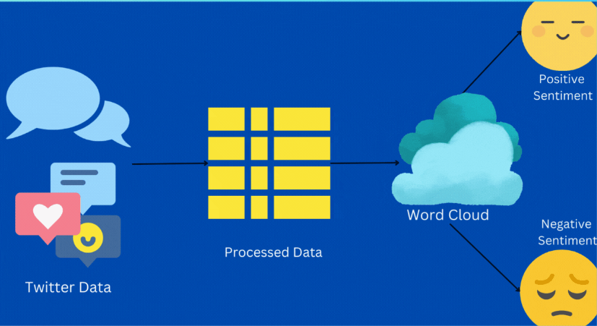

Slide 16
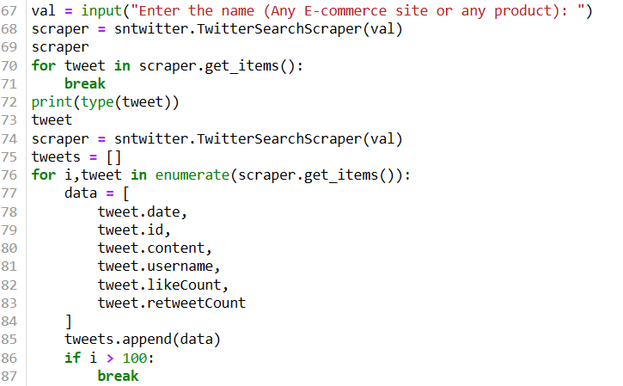
SENTIMENT ANALYSIS: STEP BY STEP PROCESS
Step 1: Data extraction from Twitter using Snscrape

Slide 17
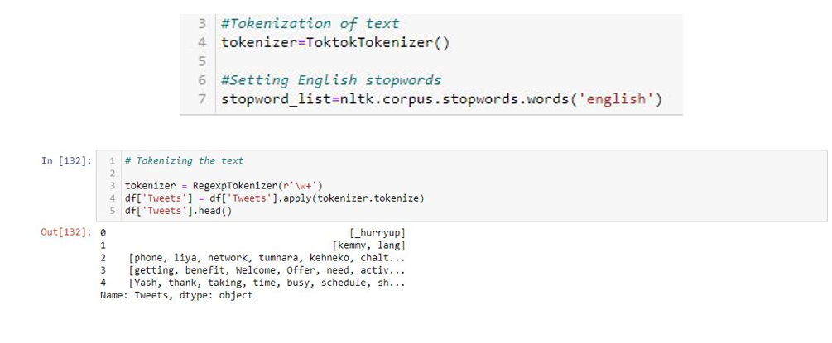
STEP 2: TOKENIZATION
Tokenization is the process by which big quantity of text is divided into smaller parts called tokens.

Slide 18
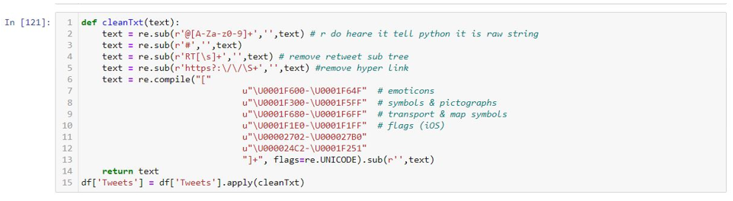
STEP 3: CLEANING THE DATA
Remove numbers
Stremming/Lemmatization
Part of speech tagging
Remove punctuation
Lowercase

Slide 19
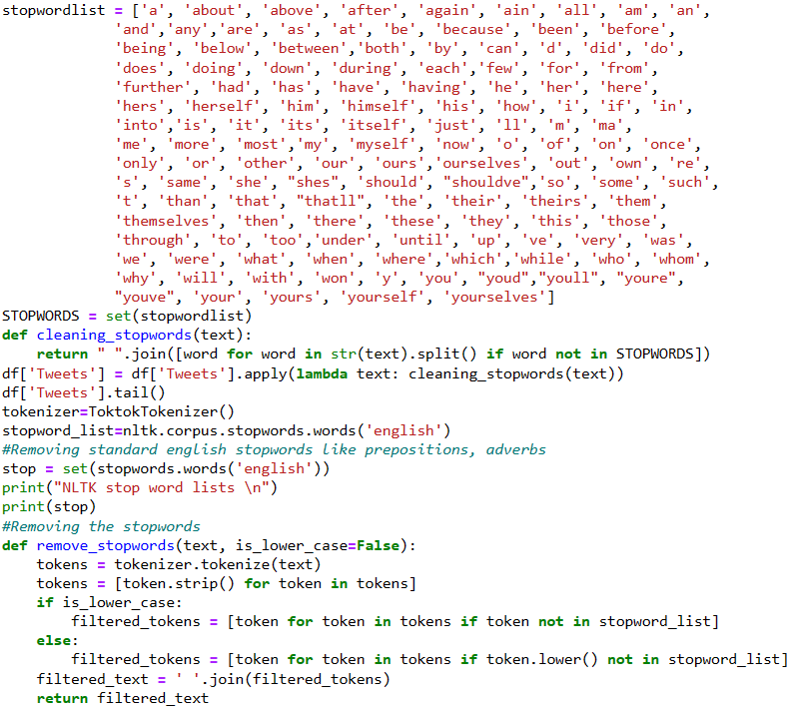
STEP 3: REMOVING THE STOP WORDS
In natural language processing, one of the most common types of pre-processing is the removal of useless words (data). These are known as stop words.

Slide 20
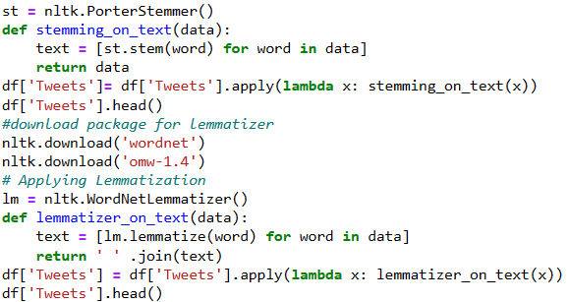
STEP 4: CLASSIFICATION
Rule-based systems that analyses sentiment using a set of manually designed rules
Automated systems that learn from data using machine learning techniques.
Hybrid systems mix rule-based and automated procedures.

Slide 21
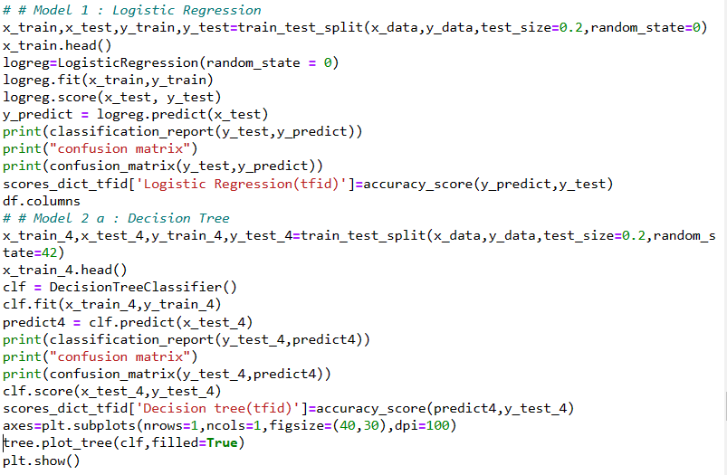
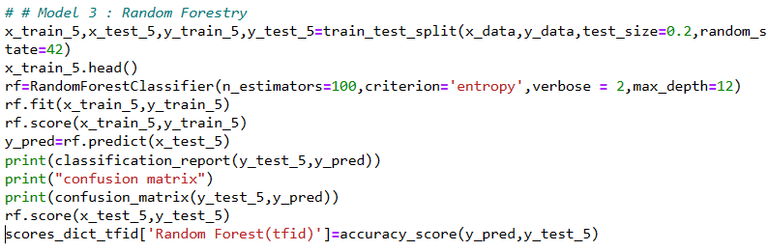
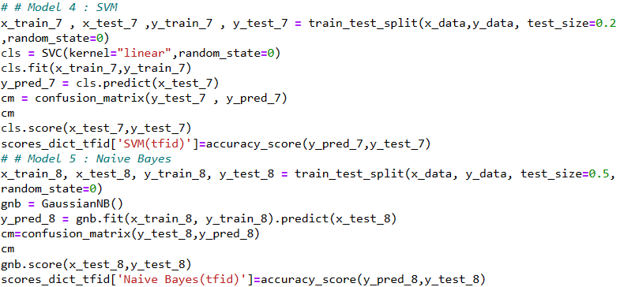
STEP 5: APPLY SUPERVISED ALGORITHM FOR CLASSIFICATION & MODELLING

Slide 22
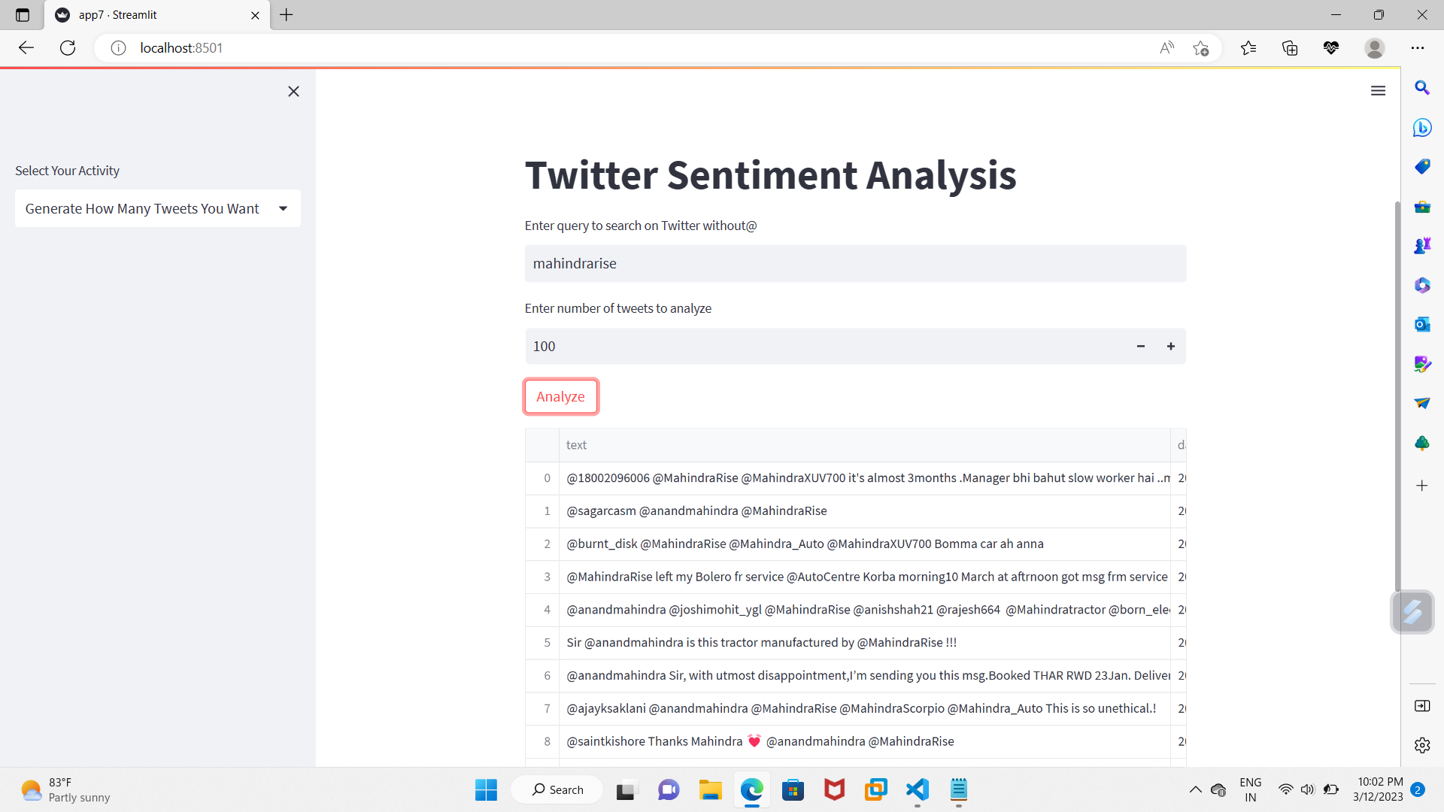
STEP 6: STREAMLIT (FRONT END USING FOR TO SHOW IN APPLICATION)
A Python-based open source app framework is called Streamlit. It enables us to quickly develop web applications for data science and machine learning.

Slide 23
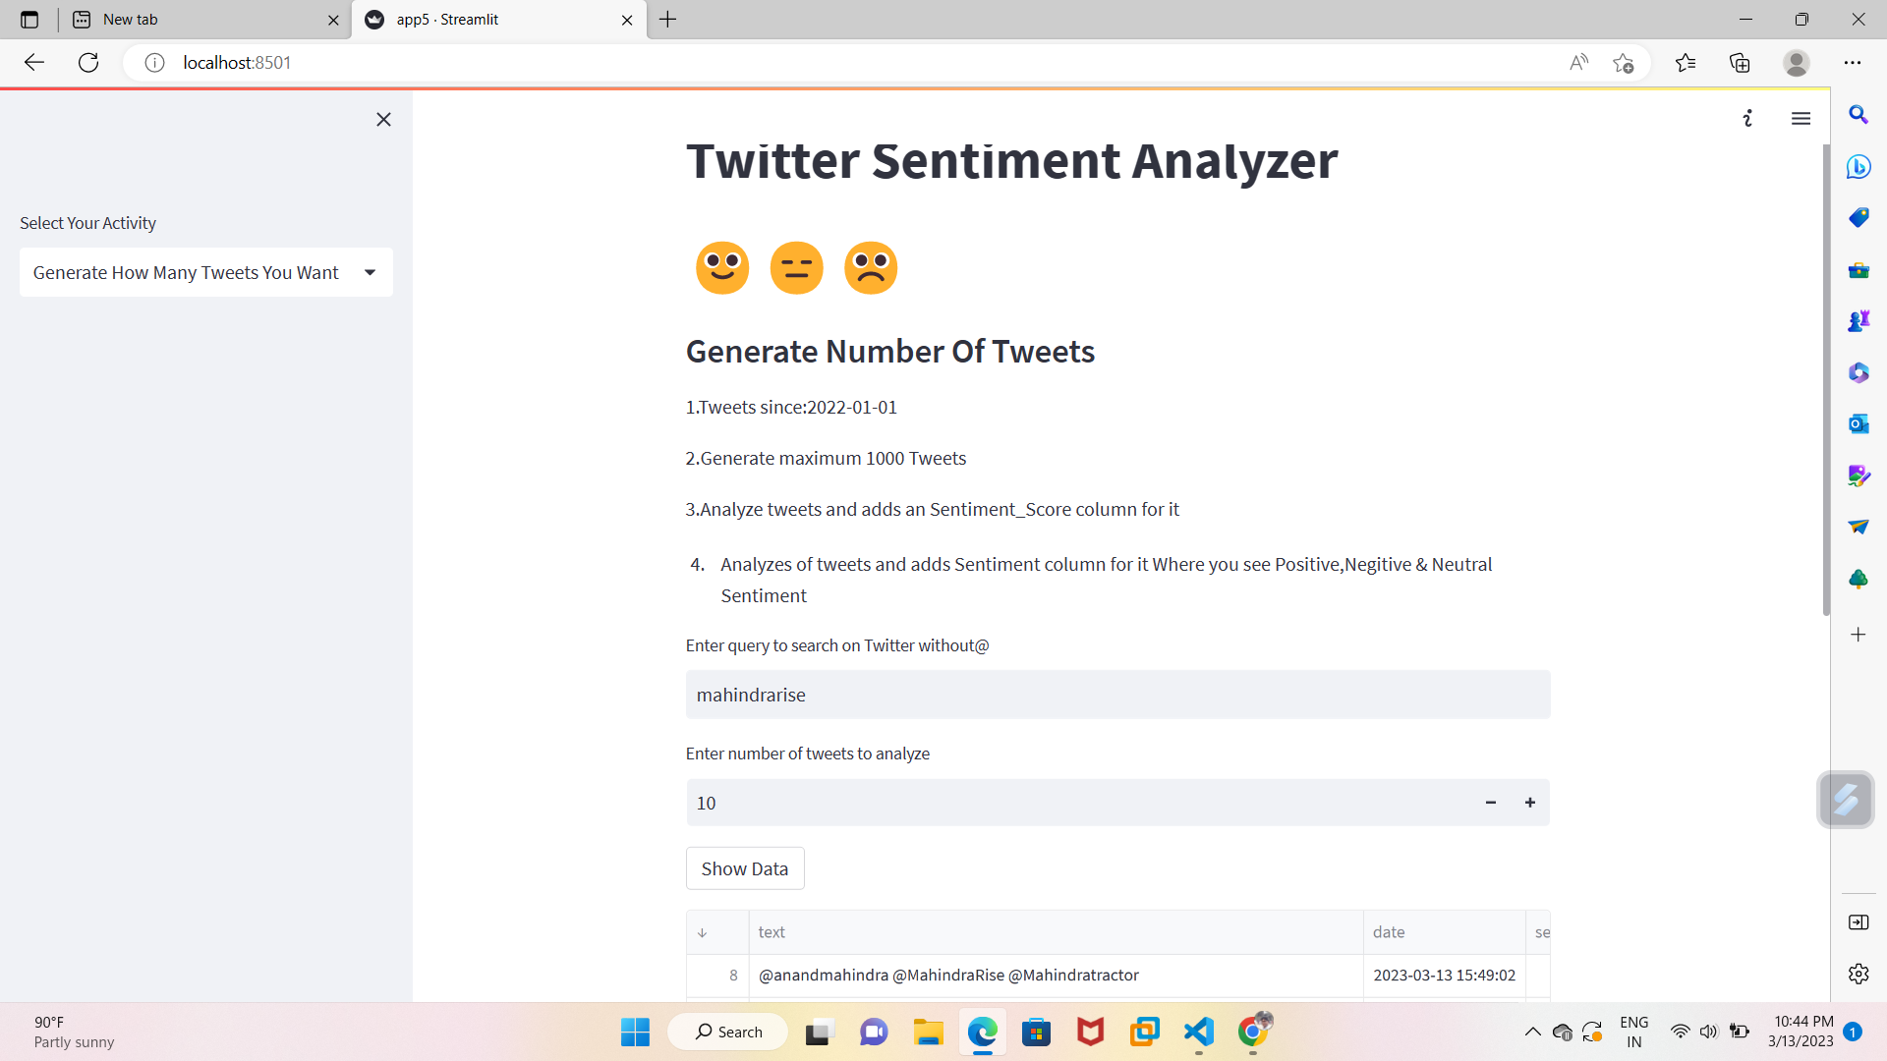
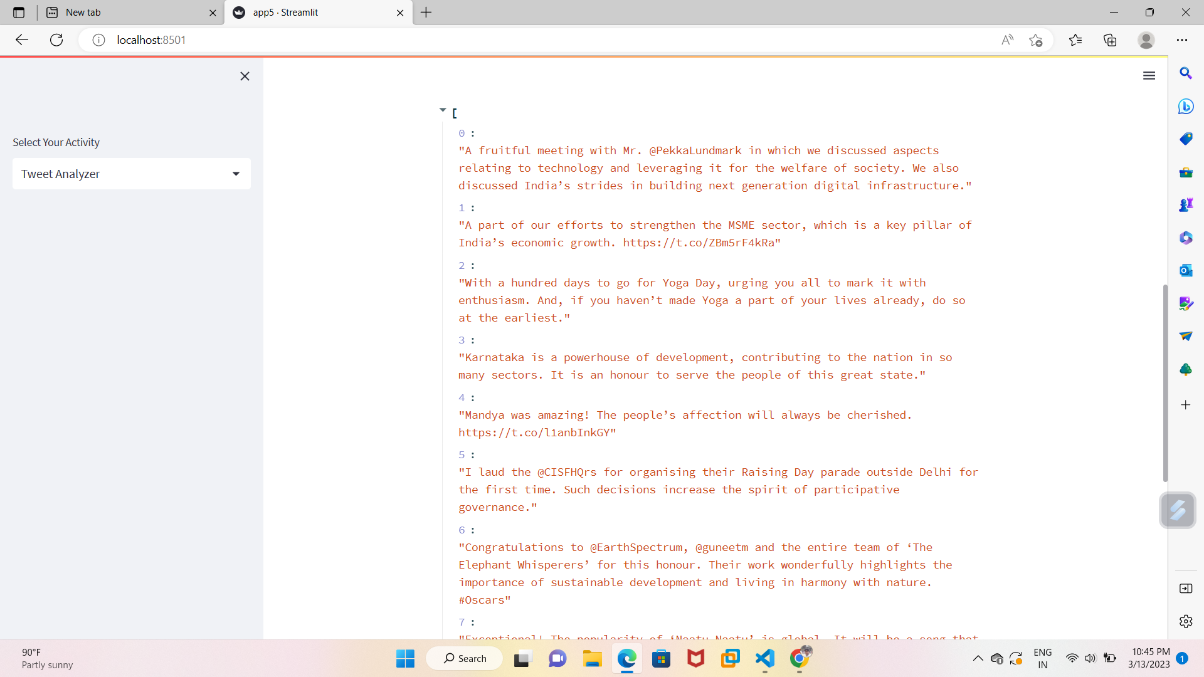
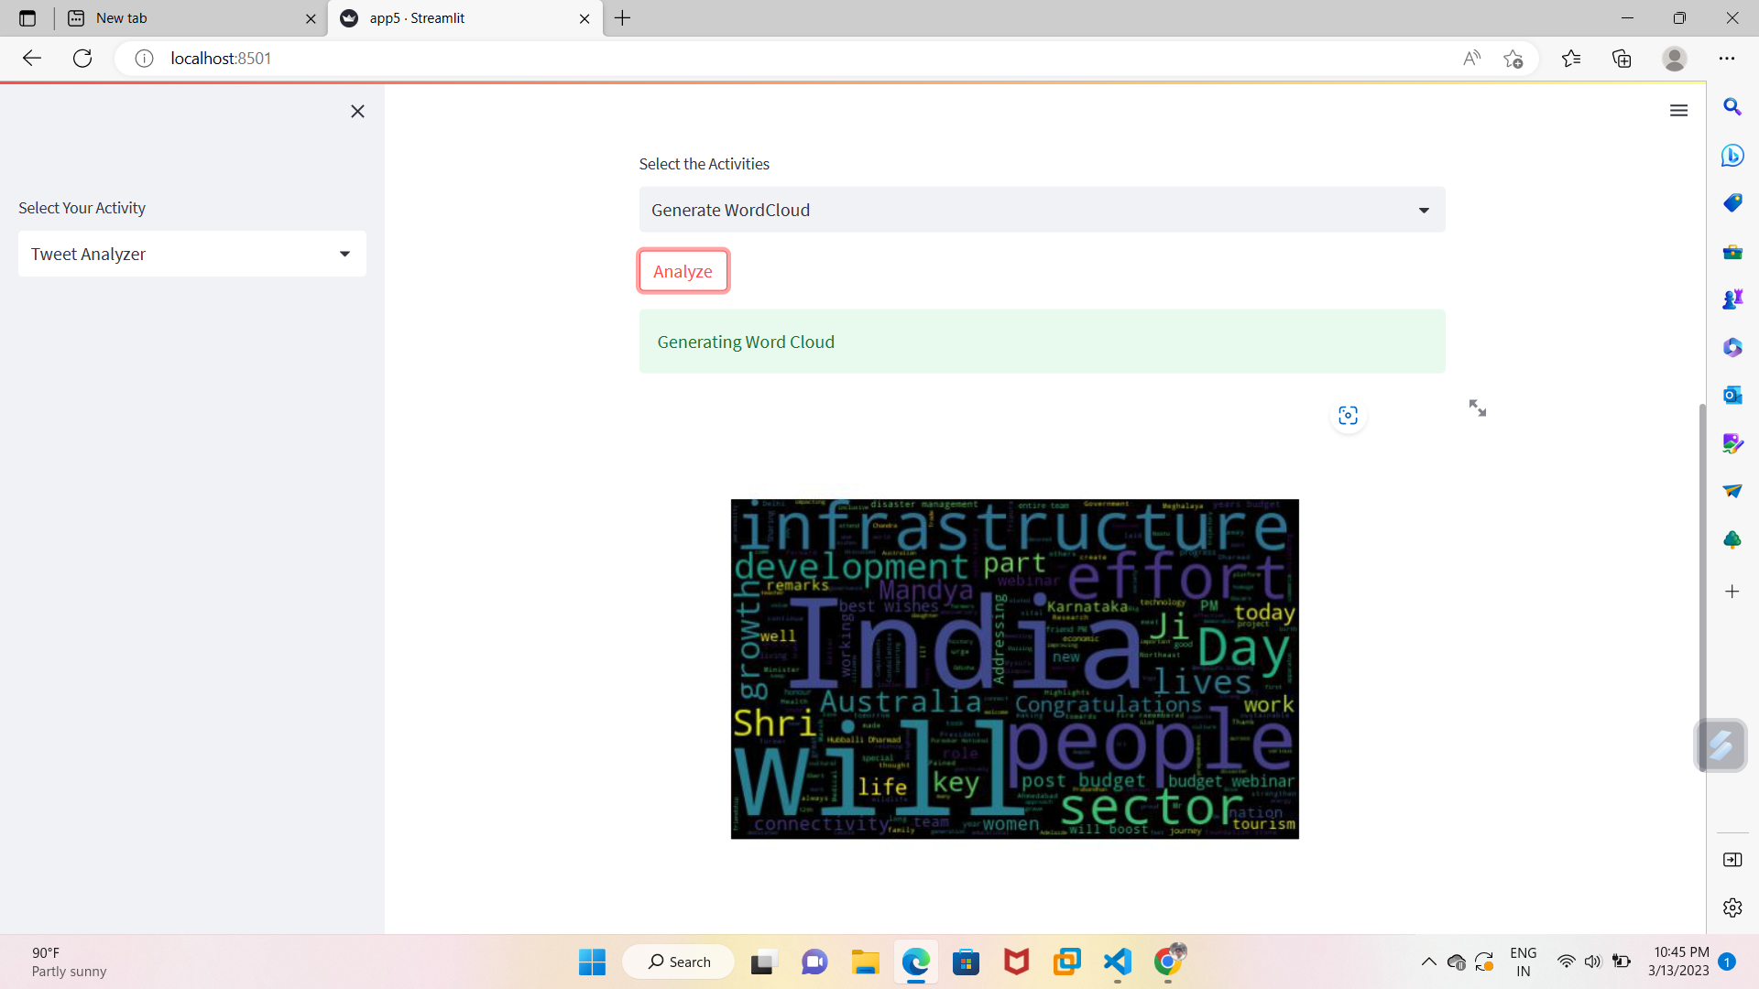
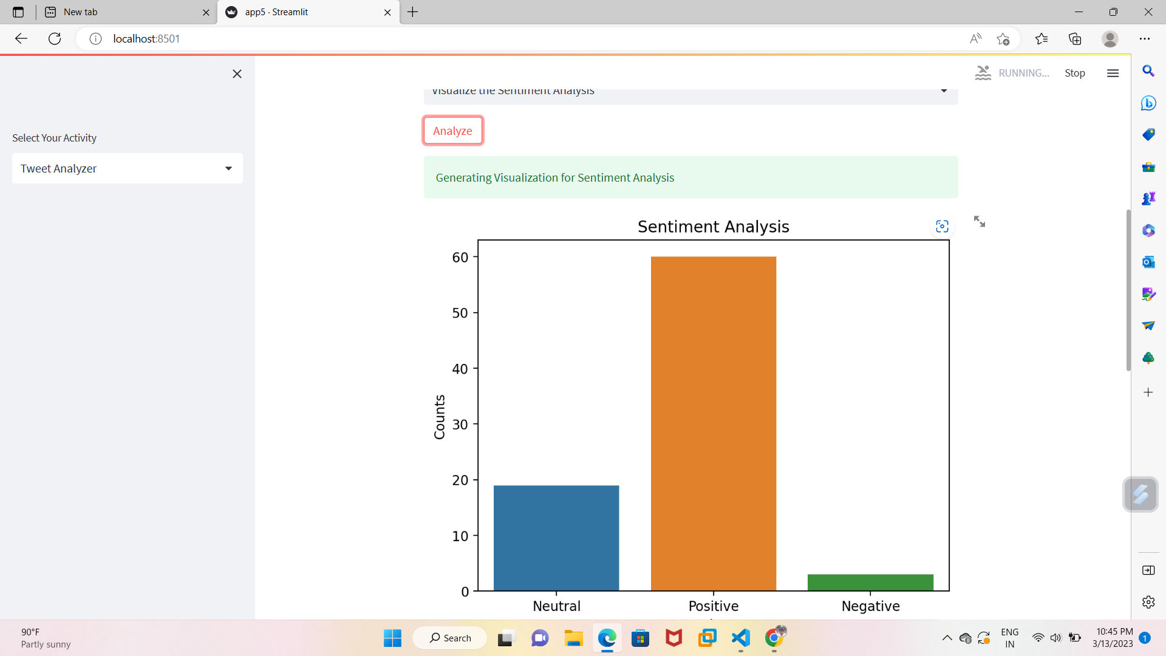

Slide 24
ALGORITHM USED:
There are some machine learning classification algorithm that are predominantly used for sentiment analysis:
Logistic Regression
A statistical technique called logistic regression is used to forecast binary events (i.e., outcomes with only two possible values). The objective of this kind of supervised learning algorithm is to estimate the likelihood of an event occurring in classification tasks
Decision tree
Entropy
Gini Index
Random forest
Classifier
SVM (Linear)
Gaussian Naïve Bayes

Slide 25
LIBRARY USES:
SNSCRAPE
TEXTBLOB
WORDCLOUD
PANDAS
STREAMLIT
RE
MATPLOTLIB
PIL
SEABORN
LANGID/DETECT
PLOTLY.GRAPH_OBJECTS
NLTK (Natural language Tool Kit)
DATETIME
SENTIMENTLNTENSITYANALYZER
STOPWORD

Slide 26
THANK YOU

